Slide 1
10. File System Implementation
Course Exercise in Operating System

Slide 2
Outline
File System Organization
  I/O Control and Devices
  Kernel I/O Subsystem
  Free Space Management
  File Header (I-Node)
  Open Files
  Directories
  File System
Shandong University

Slide 3
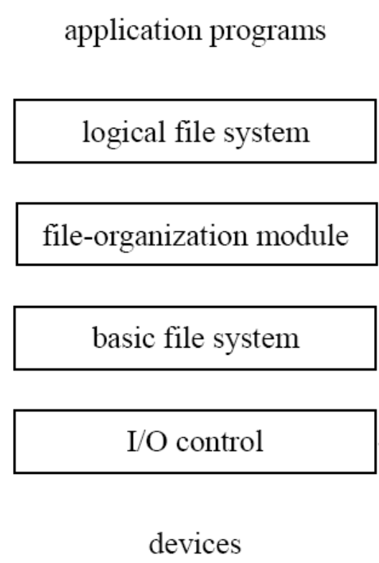
File system implementation
Overall structure
uses the directory structure to translate user file commands into requests expected by the file-organization module
[responsible for caching and other optimizations ]
deals with logical blocks and logical devices
[includes the free-space manager which tracks and allocates free disk blocks ]
deals with blocks and physical devices: [issues commands to the device drivers]
device drivers and interrupt handlers to transfer information between memory and the disk system
Shandong University

Slide 4
File System Organization
A typical file system includes 5 levels:
  logical file system,
  file organization modules,
  basic file system
  I/O control
  device.
The Nachos file system implementation has 7 modules：
  FileSystem
  Directory
  OpenFile
  FileHeader
  BitMap
  SynchDisk
  Disk
Shandong University

Slide 5
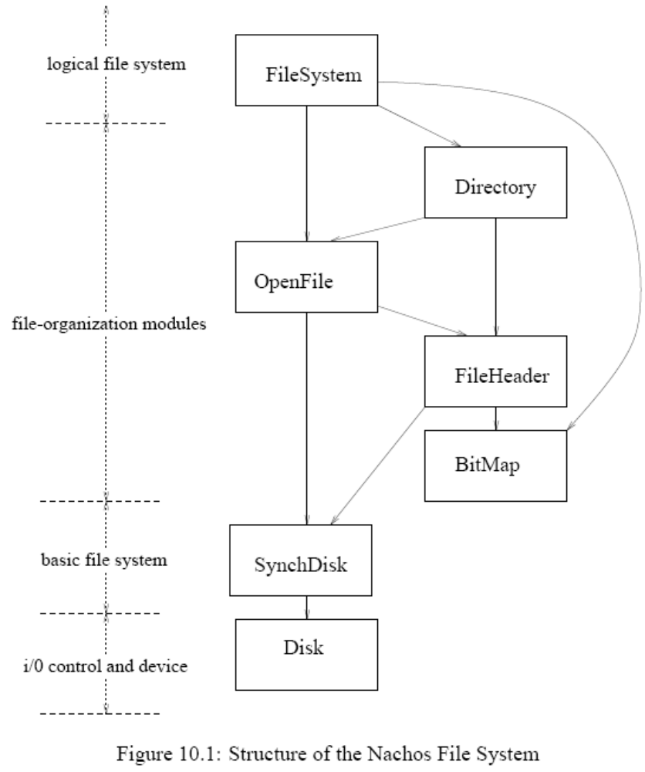
File System Organization
Shandong University

Slide 6
Outline
File System Organization
  I/O Control and Devices
  Kernel I/O Subsystem
  Free Space Management
  File Header (I-Node)
  Open Files
  Directories
  File System
Shandong University

Slide 7
File System Organization
Shandong University

Slide 8
I/O Control and Devices
The control and data transfer of the device are handled by the corresponding device controller
The device driver hides the differences among various device controllers and provides a uniform interface for I/O requests.
The interrupt-driven I/O of hard disk is simulated by two modules: Disk and SynchDisk.
  Module Disk is a simulator of the device controller and disk device itself, which we simply call hard disk.
  SynchDisk is part of the kernel I/O system which is responsible for queuing the blocked processes.
Shandong University

Slide 9
I/O Control and Devices
The source code of the hard disk simulation is in
    machine/disk.h
    machine/disk.cc
The hard disk has only one surface on a single platter, the structure of the disk is
  49 #define SectorSize 128 // number of bytes per disk sector
  50 #define SectorsPerTrack 32 // number of sectors per disk track
  51 #define NumTracks 32 // number of tracks per disk
  52 #define NumSectors (SectorsPerTrack * NumTracks)
  53 // total # of sectors per disk
Shandong University

Slide 10
I/O Control and Devices
A hard disk is an object of class Disk defined in machine/disk.h:
  55 class Disk {
  56 public:
  57 Disk(char* name, VoidFunctionPtr callWhenDone, int callArg);
  58 // Create a simulated disk.
  59 // Invoke (*callWhenDone)(callArg)
  60 // every time a request completes.
  61 ˜Disk(); // Deallocate the disk.
  62
  63 void ReadRequest(int sectorNumber, char* data);
  64 // Read/write an single disk sector.
  65 // These routines send a request to
  66 // the disk and return immediately.
  67 // Only one request allowed at a time!
  68 void WriteRequest(int sectorNumber, char* data);
  69
  70 void HandleInterrupt(); // Interrupt handler, invoked when
  71 // disk request finishes.
  72
  ...
Shandong University

Slide 11
I/O Control and Devices
    78 private:
    79 int fileno; // UNIX file number for simulated disk
    80 VoidFunctionPtr handler; // Interrupt handler, to be invoked
    81 // when any disk request finishes
    82 int handlerArg; // Argument to interrupt handler
    83 bool active; // Is a disk operation in progress?
    84 int lastSector; // The previous disk request
    85 int bufferInit; // When the track buffer started
    86 // being loaded
    ...
    91 };
Shandong University

Slide 12
I/O Control and Devices
115 void
116 Disk::ReadRequest(int sectorNumber, char* data)
117 {
118 int ticks = ComputeLatency(sectorNumber, FALSE);
119
120 ASSERT(!active); // only one request at a time
121 ASSERT((sectorNumber >= 0) && (sectorNumber < NumSectors));
122
123 DEBUG(’d’, "Reading from sector %d\n", sectorNumber);
124 Lseek(fileno, SectorSize * sectorNumber + MagicSize, 0);
125 Read(fileno, data, SectorSize);
126 if (DebugIsEnabled(’d’))
127 PrintSector(FALSE, sectorNumber, data);
128
129 active = TRUE;
130 UpdateLast(sectorNumber);
131 stats->numDiskReads++;
132 interrupt->Schedule(DiskDone, (int) this, ticks, DiskInt);
133 }
Shandong University

Slide 13
I/O Control and Devices
132 interrupt->Schedule(DiskDone, (int) this, ticks, DiskInt);
The system interrupt simulator interrupt is called to register a future event in ticks ticks time
This event represents the time when the read operation of the hard disk (not the UNIX file) is finished.
When this event arrives, the interrupt hardware simulator ( class Interrupt) will cause interrupt handler DiskDone to be executed with the argument provided, i.e. (int) this.
DiskDone is a static function define in line 29 of disk.cc:
28 // dummy procedure because we can’t take a pointer of a
member function
29 static void DiskDone(int arg) { ((Disk *)arg)->HandleInterrupt(); }
Shandong University

Slide 14
I/O Control and Devices
DiskDone simply uses the argument arg as a pointer to the object of Disk and calls its member function HandleInterrupt()
  161 void
  162 Disk::HandleInterrupt ()
  163 {
  164 active = FALSE;
  165 (*handler)(handlerArg);
  166 }
This function sets variable active back to FALSE again
then calls the interrupt handler in the kernel I/O subsystem.
Shandong University

Slide 15
Outline
File System Organization
  I/O Control and Devices
  Kernel I/O Subsystem
  Free Space Management
  File Header (I-Node)
  Open Files
  Directories
  File System
Shandong University

Slide 16
File System Organization
Shandong University

Slide 17
Kernel I/O Subsystem
With regard to interrupt-driven I/O of the hard disk, we should：
  provide the mechanism to block the processes issuing hard disk I/O here.
  provide the handler for disk I/O completion interrupts
  synchronize concurrent disk accesses by multiple processes or threads.
Shandong University

Slide 18
Kernel I/O Subsystem
All these tasks are accomplished by class SynchDisk defined in filesys/synchdisk.h:
27 class SynchDisk {
28 public:
29 SynchDisk(char* name); // Initialize a synchronous disk,
30 // by initializing the raw Disk.
31 ˜SynchDisk(); // De-allocate the synch disk data
32
33 void ReadSector(int sectorNumber, char* data);
34 // Read/write a disk sector, returning
35 // only once the data is actually read
36 // or written. These call
37 // Disk::ReadRequest/WriteRequest,
38 // then wait until the request is done.
39 void WriteSector(int sectorNumber, char* data);
Shandong University

Slide 19
Kernel I/O Subsystem
40
41 void RequestDone(); // Called by the disk device interrupt
42 // handler, to signal that the
43 // current disk operation is complete.
44
45 private:
46 Disk *disk; // Raw disk device
47 Semaphore *semaphore; // To synchronize requesting thread
48 // with the interrupt handler
49 Lock *lock; // Only one read/write request
50 // can be sent to the disk at a time
51 };
Shandong University

Slide 20
Kernel I/O Subsystem
The I/O operations ReadSector and WriteSector are implemented by calling the corresponding I/O operations of the underlying raw hard disk with appropriate synchronization.
  72 void
  73 SynchDisk::ReadSector(int sectorNumber, char* data)
  74 {
  75 lock->Acquire(); // only one disk I/O at a time
  76 disk->ReadRequest(sectorNumber, data);
  77 semaphore->P(); // wait for interrupt
  78 lock->Release();
  79 }
  94
Shandong University

Slide 21
Kernel I/O Subsystem
SynchDisk::SynchDisk(char* name)
{
semaphore = new Semaphore("synch disk", 0);
lock = new Lock("synch disk lock");
disk = new Disk(name, DiskRequestDone, (_int) this);
}
static void
DiskRequestDone (_int arg)
{
SynchDisk* dsk = (SynchDisk *)arg; // disk -> dsk
dsk->RequestDone(); // disk -> dsk
}
void
SynchDisk::RequestDone()
{
semaphore->V();
}
Shandong University
Notes:
C++中不允许传递成员函数的指针，所以用一个静态函数作中转

Slide 22
Outline
File System Organization
  I/O Control and Devices
  Kernel I/O Subsystem
  Free Space Management
  File Header (I-Node)
  Open Files
  Directories
  File System
Shandong University

Slide 23
Free Space Management
The raw hard disk consists of sectors.
A sector is the smallest unit of storage as far as the disk I/O operation concerned.
In the Nachos system, the free storage of sectors of the disk are managed by a data structure called BitMap.
Shandong University

Slide 24
File System Organization
Shandong University

Slide 25
Free Space Management
The definition of class BitMap can be found in ../userprog/bitmap.h
34 class BitMap {
35 public:
36 BitMap(int nitems); // Initialize a bitmap, with "nitems" bits
37 // initially, all bits are cleared.
38 ˜BitMap(); // De-allocate bitmap
39
40 void Mark(int which); // Set the "nth" bit
41 void Clear(int which); // Clear the "nth" bit
42 bool Test(int which); // Is the "nth" bit set?
43 int Find(); // Return the # of a clear bit, and as a side
44 // effect, set the bit.
45 // If no bits are clear, return -1.
46 int NumClear(); // Return the number of clear bits
47
48 void Print(); // Print contents of bitmap
Shandong University

Slide 26
Free Space Management
49
50 // These aren’t needed until FILESYS, when we will need to
51 // read and write the bitmap to a file
52 void FetchFrom(OpenFile *file); // fetch contents from disk
53 void WriteBack(OpenFile *file); // write contents to disk
54
55 private:
56 int numBits; // number of bits in the bitmap
57 int numWords; // number of words of bitmap
// storage
58 // (rounded up if numBits is not a
59 // multiple of the number of bits in
60 // a word)
61 unsigned int *map; // bit storage
62 };
Shandong University

Slide 27
Outline
File System Organization
  I/O Control and Devices
  Kernel I/O Subsystem
  Free Space Management
  File Header (I-Node)
  Open Files
  Directories
  File System
Shandong University

Slide 28
File System Organization
Shandong University

Slide 29
File Header (I-Node)
File header, also known as i-node in UNIX operating systems, is an important data structure in file systems.
Each file has a file header which stores the size of the file as well as the locations of the data sectors of the file.
In the Nachos file system, a simple flat index allocation is used.
Shandong University

Slide 30
File Header (I-Node)
The class FileHeader is defined in filesys/filehdr.h.
The private data members of the class are:
  60 int numBytes; // Number of bytes in the file
  61 int numSectors; // Number of data sectors in
  //the file
  62 int dataSectors[NumDirect]; // Disk sector numbers for
  //each data
  63 // block in the file
dataSectors[] is the index table which gives the disk sector number for each data block.
Shandong University

Slide 31
File Header (I-Node)
NumDirect is the size of the index table dataSectors[].
It is the maximum number of the data blocks a Nachos file can have
the file header has the same size as a sector on the disk
  20 #define NumDirect ((SectorSize - 2 * sizeof(int)) / sizeof(int))
  21 #define MaxFileSize (NumDirect * SectorSize)
Shandong University
Notes:
2*sizeof() 指的是前面一页60-61两行的整数所占用的空间

Slide 32
File Header (I-Node)
The functions of class FileHeader are:
40 bool Allocate(BitMap *bitMap, int fileSize); // Initialize a file header,
41 // including allocating space
42 // on disk for the file data
43 void Deallocate(BitMap *bitMap); // De-allocate this file’s
44 // data blocks
45
46 void FetchFrom(int sectorNumber); // Initialize file header from disk
47 void WriteBack(int sectorNumber); // Write modifications to file header
48 // back to disk
49
50 int ByteToSector(int offset); // Convert a byte offset into the file
51 // to the disk sector containing
52 // the byte
53
54 int FileLength(); // Return the length of the file
55 // in bytes
56
57 void Print(); // Print the contents of the file.
Shandong University

Slide 33
File Header (I-Node)
41 bool
42 FileHeader::Allocate(BitMap *freeMap, int fileSize)
43 {
44 numBytes = fileSize;
45 numSectors = divRoundUp(fileSize, SectorSize);
46 if (freeMap->NumClear() < numSectors)
47 return FALSE; // not enough space
48
49 for (int i = 0; i < numSectors; i++)
50 dataSectors[i] = freeMap->Find();
51 return TRUE;
52 }
This function is called when a new file is created.
In Nachos, a file has a fixed size when it is created.
After the number of sectors needed is found ，the data allocation for the sectors is done by consulting the free map (freeMap) of the hard disk
Shandong University

Slide 34
File Header (I-Node)
  //----------------------------------------------------------------------
  // FileHeader::FetchFrom
  // Fetch contents of file header from disk.
  //
  // "sector" is the disk sector containing the file header
  //----------------------------------------------------------------------
  void
  FileHeader::FetchFrom(int sector)
  {
  synchDisk->ReadSector(sector, (char *)this);
  }
  //----------------------------------------------------------------------
  void
  FileHeader::WriteBack(int sector)
  {
  synchDisk->WriteSector(sector, (char *)this);
  }
Shandong University

Slide 35
Outline
File System Organization
  I/O Control and Devices
  Kernel I/O Subsystem
  Free Space Management
  File Header (I-Node)
  Open Files
  Directories
  File System
Shandong University

Slide 36
File System Organization
Shandong University

Slide 37
Open Files
In UNIX systems, each process has a open file table.
The data structure of open file should provide:
  the current seek position of the open file
  a reference to the i-node of the open file
  functions to access the file such as read and write
In Nachos file system, this data structure is provided through class OpenFile defined in filesys/openfile.h
Shandong University

Slide 38
Open Files
The integer seekPosition and the pointer to the file header (i-node) of the file are the data members of an open file.
  FileHeader *hdr; // Header for this file
  int seekPosition; // Current position within the file
The constructor of the class loads the i-node of the file from the disk and set the seek position to 0.
    27 OpenFile::OpenFile(int sector)
    28 {
    29 hdr = new FileHeader;
    30 hdr->FetchFrom(sector);
    31 seekPosition = 0;
    32 }
The sector number for the i-node of the file is provided by the higher level module Directory
Shandong University

Slide 39
Open Files
Functions Read(..) and Write(..) are implemented by using functions ReadAt(..) and WriteAt(..), respectively.
  int
  OpenFile::ReadAt(char *into, int numBytes, int position)
  {
  int fileLength = hdr->FileLength();
  int i, firstSector, lastSector, numSectors;
  char *buf;
  if ((numBytes <= 0) || (position >= fileLength))
  return 0; // check request
  if ((position + numBytes) > fileLength)
  numBytes = fileLength - position;
  DEBUG('f', "Reading %d bytes at %d, from file of length %d.\n", numBytes, position, fileLength);
Shandong University

Slide 40
Open Files
  firstSector = divRoundDown(position, SectorSize);
  lastSector = divRoundDown(position + numBytes - 1, SectorSize);
  numSectors = 1 + lastSector - firstSector;
  // read in all the full and partial sectors that we need
  buf = new char[numSectors * SectorSize];
  for (i = firstSector; i <= lastSector; i++)
  synchDisk->ReadSector(hdr->ByteToSector(i * SectorSize),
  &buf[(i - firstSector) * SectorSize]);
  // copy the part we want
  bcopy(&buf[position - (firstSector * SectorSize)], into, numBytes);
  delete [] buf;
  return numBytes;
  }
Shandong University

Slide 41
Outline
File System Organization
  I/O Control and Devices
  Kernel I/O Subsystem
  Free Space Management
  File Header (I-Node)
  Open Files
  Directories
  File System
Shandong University

Slide 42
File System Organization
Shandong University

Slide 43
Directories
The directory structure of the Nachos file system is very simple: there is one directory and all files belong to this directory.
The data structure of Nachos directory is defined as class Directory in ../filesys/directory.h
    51 class Directory {
    52 public:
    53 Directory(int size); // Initialize an empty directory
    54 // with space for "size" files
    55 ˜Directory(); // De-allocate the directory
    56
    57 void FetchFrom(OpenFile *file); // Init directory contents from disk
    58 void WriteBack(OpenFile *file); // Write modifications to
    59 // directory contents back to disk
Shandong University

Slide 44
Directories
  61 int Find(char *name); // Find the sector number of the
  62 // FileHeader for file: "name"
  63
  64 bool Add(char *name, int newSector); // Add a file name into the directory
  65
  66 bool Remove(char *name); // Remove a file from the directory
  67
  68 void List(); // Print the names of all the files
  69 // in the directory
  70 void Print(); // Verbose print of the contents
  71 // of the directory -- all the file
  72 // names and their contents.
  73
  74 private:
  75 int tableSize; // Number of directory entries
  76 DirectoryEntry *table; // Table of pairs:
  77 // <file name, file header location>
  78
  79 int FindIndex(char *name); // Find the index into the directory
  80 // table corresponding to "name"
  81 };
Shandong University

Slide 45
Directories
Private data member table is a pointer to a table of file-name and i-node sector number pairs called DirectoryEntry.
    32 class DirectoryEntry {
    33 public:
    34 bool inUse; // Is this directory entry in use?
    35 int sector; // Location on disk to find the
    36 // FileHeader for this file
    37 char name[FileNameMaxLen + 1]; // Text name for file,
    //with +1 for
    38 // the trailing ’\0’
    39 };
Shandong University

Slide 46
Directories
//----------------------------------------------------------------------
// Directory::Directory
// Initialize a directory; initially, the directory is completely
// empty. If the disk is being formatted, an empty directory
// is all we need, but otherwise, we need to call FetchFrom in order
// to initialize it from disk.
//
// "size" is the number of entries in the directory
//----------------------------------------------------------------------
Directory::Directory(int size)
{
table = new DirectoryEntry[size];
tableSize = size;
for (int i = 0; i < tableSize; i++)
table[i].inUse = FALSE;
}
Shandong University

Slide 47
Directories
Functions Add(..) and Remove(..) are used to add and remove a directory entry.
  129 bool
  130 Directory::Add(char *name, int newSector)
  131 {
  132 if (FindIndex(name) != -1)
  133 return FALSE;
  134
  135 for (int i = 0; i < tableSize; i++){
  136 if (!table[i].inUse) {
  137 table[i].inUse = TRUE;
  138 strncpy(table[i].name, name, FileNameMaxLen);
  139 table[i].sector = newSector;
  140 return TRUE;
  141 }
  142 return FALSE; // no space. Fix when we have extensible files.
  143 }
Shandong University

Slide 48
Outline
File System Organization
  I/O Control and Devices
  Kernel I/O Subsystem
  Free Space Management
  File Header (I-Node)
  Open Files
  Directories
  File System
Shandong University

Slide 49
File System Organization
Shandong University

Slide 50
File System
There are two open file pointers associated with the file system:
  one for the free bit map file
  and the other for the directory file.
These two files are always open while the file system exists.
Shandong University

Slide 51
File System
  80 FileSystem::FileSystem(bool format)
  81 {
  82 DEBUG(’f’, "Initializing the file system.\n");
  83 if (format) {
  84 BitMap *freeMap = new BitMap(NumSectors);
  85 Directory *directory = new Directory(NumDirEntries);
  86 FileHeader *mapHdr = new FileHeader;
  87 FileHeader *dirHdr = new FileHeader;
  88
  89 DEBUG(’f’, "Formatting the file system.\n");
  90
The constructor first creates a bit map and a directory (not files yet) in lines 84-85.
Lines 86-87 creates i-nodes for the bit map file and the directory file.
Shandong University

Slide 52
File System
  91 // First, allocate space for FileHeaders for the directory and bitmap
  92 // (make sure no one else grabs these!)
  93 freeMap->Mark(FreeMapSector);
  94 freeMap->Mark(DirectorySector);
FreeMapSector and DirectorySector are defined as 0 and 1, respectively.
Lines 93-94 mark sector 0 and sector 1 of the hard disk.
Shandong University

Slide 53
File System
  95
  96 // Second, allocate space for the data blocks containing the contents
  97 // of the directory and bitmap files. There better be enough space!
  98
  99 ASSERT(mapHdr->Allocate(freeMap, FreeMapFileSize));
  100 ASSERT(dirHdr->Allocate(freeMap, DirectoryFileSize));
  101
  102 // Flush the bitmap and directory FileHeaders back to disk
  103 // We need to do this before we can "Open" the file, since open
  104 // reads the file header off of disk (and currently the disk has garbage
  105 // on it!).
  106
  107 DEBUG(’f’, "Writing headers back to disk.\n");
  108 mapHdr->WriteBack(FreeMapSector);
  109 dirHdr->WriteBack(DirectorySector);
In lines 99-100, the disk space for the bit map file and the directory file is allocated.
At this point, the i-nodes of the bit map file and the directory file are valid.
In lines 108-109, their i-nodes (in memory) are written back to sectors 0 and 1.
Shandong University

Slide 54
File System
  110
  111 // OK to open the bitmap and directory files now
  112 // The file system operations assume these two files are left open
  113 // while Nachos is running.
  114
  115 freeMapFile = new OpenFile(FreeMapSector);
  116 directoryFile = new OpenFile(DirectorySector);
  117
  118 // Once we have the files "open", we can write the initial version
  119 // of each file back to disk. The directory at this point is completely
  120 // empty; but the bitmap has been changed to reflect the fact that
  121 // sectors on the disk have been allocated for the file headers and
  122 // to hold the file data for the directory and bitmap.
  123
  124 DEBUG(’f’, "Writing bitmap and directory back to disk.\n");
  125 freeMap->WriteBack(freeMapFile); // flush changes to disk
  126 directory->WriteBack(directoryFile);
Then, these files are opened by lines 115-116.
Now it is time to write the contents of the bit map file and the directory file to the data sectors allocated to them. This is done in line 125 and 126.
Shandong University

Slide 55
File System
  127
  128 if (DebugIsEnabled(’f’)) {
  129 freeMap->Print();
  130 directory->Print();
  131
  132 delete freeMap;
  133 delete directory;
  134 delete mapHdr;
  135 delete dirHdr;
  136 }
  137 } else {
  138 // if we are not formatting the disk, just open the files representing
  139 // the bitmap and directory; these are left open while Nachos is running
  140 freeMapFile = new OpenFile(FreeMapSector);
  141 directoryFile = new OpenFile(DirectorySector);
  142 }
  143 }
  At this point, all information of these two files are saved in the disk. The i-nodes and the contents of each of them are consistent.
  The data structures pointed by freeMap, directory, mapHdr and dirHdr are not used any more and, thus, deleted (lines 132-135) before the function finishes.
Shandong University

Slide 56
File System
bool
FileSystem::Create(char *name, int initialSize)
{
Directory *directory;
BitMap *freeMap;
FileHeader *hdr;
int sector;
bool success;
DEBUG('f', "Creating file %s, size %d\n", name, initialSize);
directory = new Directory(NumDirEntries);
directory->FetchFrom(directoryFile);
if (directory->Find(name) != -1)
success = FALSE; // file is already in directory
else {
freeMap = new BitMap(NumSectors);
freeMap->FetchFrom(freeMapFile);
sector = freeMap->Find(); // find a sector to hold the file header
if (sector == -1)
success = FALSE; // no free block for file header
Shandong University

Slide 57
File System
  else if (!directory->Add(name, sector))
  success = FALSE; // no space in directory
  else {
    hdr = new FileHeader;
    if (!hdr->Allocate(freeMap, initialSize))
    success = FALSE; // no space on disk for data
    else {
    success = TRUE;
    // everthing worked, flush all changes back to disk
    hdr->WriteBack(sector);
    directory->WriteBack(directoryFile);
    freeMap->WriteBack(freeMapFile);
    }
    delete hdr;
  }
  delete freeMap;
}
delete directory;
return success;
}
Shandong University

Slide 58
Laboratory
Laboratory 4 &5
Shandong University

